Slide 1
Avian Influenza
Assist. Prof. Dr. Hussein ALNaji

Slide 2
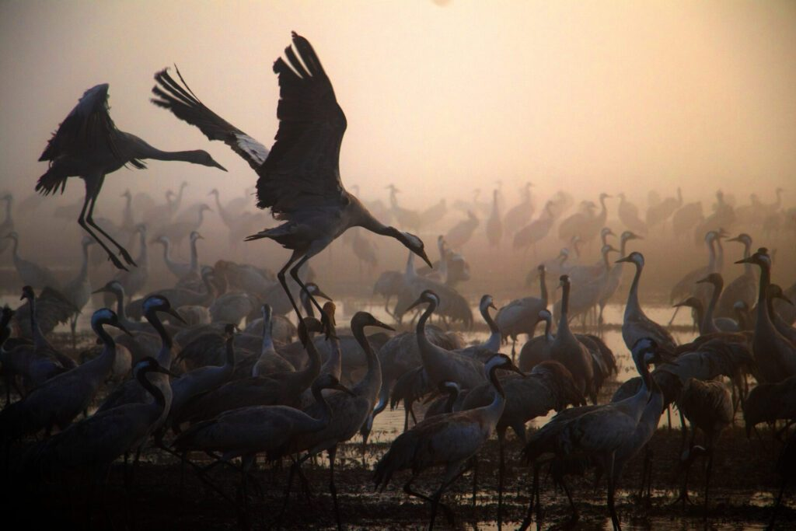
Avian influenza is a highly contagious viral disease that affects both domestic and wild birds. Avian influenza viruses have also been isolated, although less frequently, from mammalian species, including humans. caused by Type A influenza viruses. These viruses are divided into subtypes based on two proteins on the surface of the virus- hemagglutinin (HA) and neuraminidase (NA). There are 16 HA subtypes (H1-H16) and 9 NA subtypes (N1-N9). These HA and NA subtypes form many different combinations (i.e H9N2, H5N1, H7N2, etc.).

Slide 3
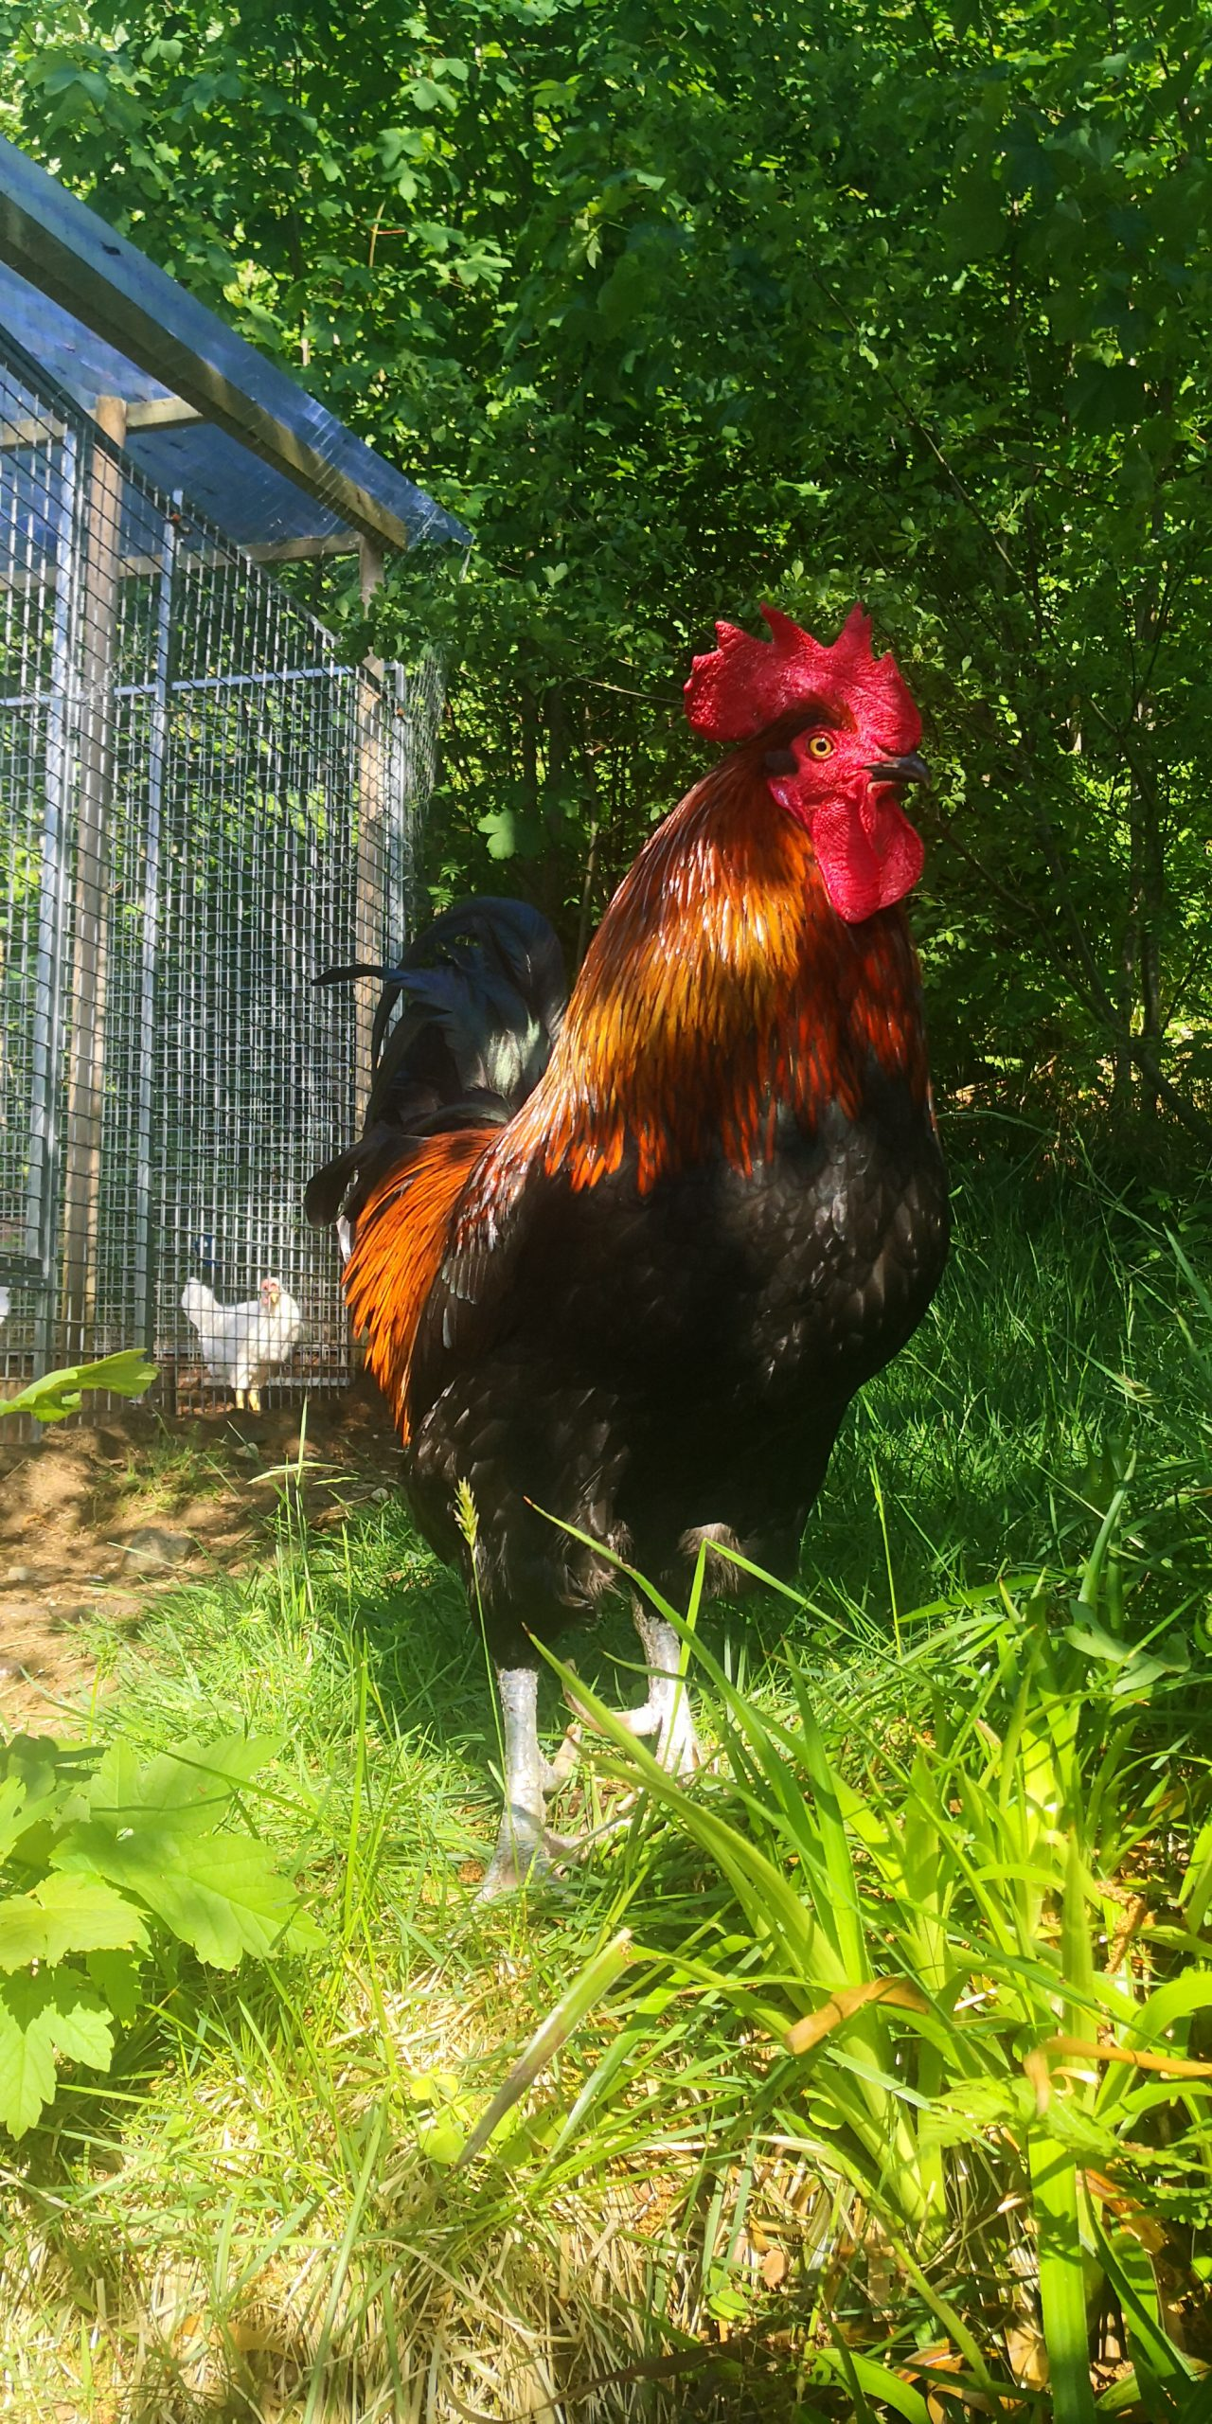
The many strains of avian influenza viruses can generally be classified into two categories according to the severity of the disease in poultry:
1- low pathogenicity avian influenza (LPAI) that typically causes little or no clinical signs;
2- high pathogenicity avian influenza (HPAI) that can cause severe clinical signs and possible high mortality rates.
However, some HPAI strains have the ability to infect humans, posing a threat to public health. The main risk factor is the direct or indirect exposure to infected animals or environments and surfaces contaminated by feces.

Slide 4
Transmission
1- The most common way for the virus to enter a territory is through migratory wild birds.
2- The main risk factor for transmission from birds to humans is direct or indirect contact with infected animals or with environments and surfaces contaminated by feces.
3- Plucking, handling infected poultry carcasses.
4- Preparing poultry for consumption, especially in domestic settings, may also be risk factors

Slide 5
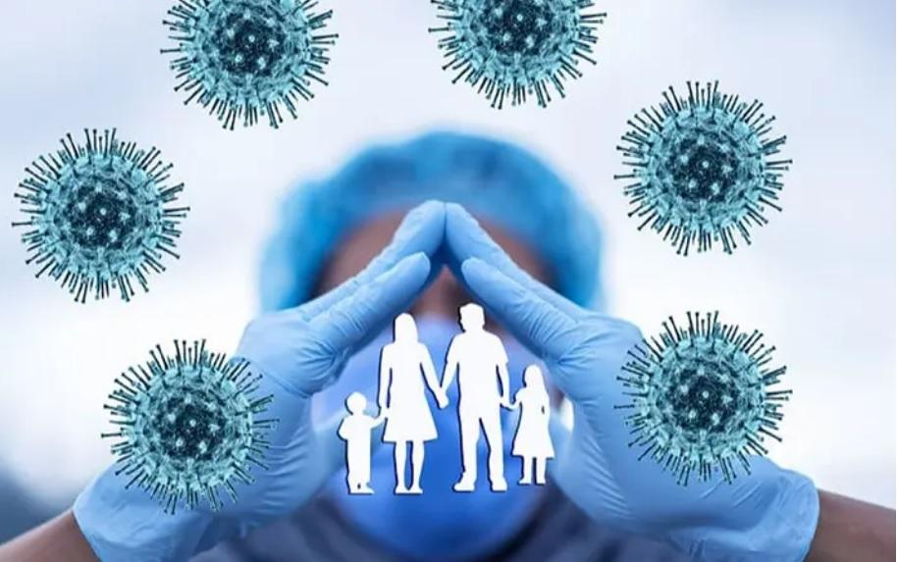
Epidemiology of human infections.
1- A few influenza A(H5N1) human cases have been linked to consumption of dishes made with raw contaminated poultry blood.
2- A(H7N9) viruses were reported for the first time in China.
3- A(H5N6) viruses have been reported almost exclusively from China

Slide 6
Treatment
1- For people in good health, CSD will likely go away without treatment.
2- Anti-inflammatory medicine like ibuprofen or naproxen
3- A hot compress can help, too.
4- To relieve very tight, painful glands, your doctor may gently insert a needle into them and drain the fluid.

Slide 7
Prevention
Influenza viruses are impossible to eradicate and zoonotic infections will continue to occur.
1- To minimize public health risk, quality surveillance in both animal and human populations, thorough investigation of every human infection and risk-based pandemic planning are essential.
2- The public should minimize contact with animals in areas known to be affected by animal influenza viruses.
3- The public should strictly avoid contact with sick or dead animals.
4- Everyone should perform hand hygiene, preferably washing their hands either with soap and running water.

Slide 8
Thank you

